Slide 1
What causes bugs?
Joshua Sunshine

Slide 2
Bug taxonomy
Bug components:
Fault/Defect
Error
Failure
Bug categories
Post/pre release
Process stage
Hazard = Severity x Probability

Slide 3
Historical Data
Module fault history is predictive of future faults.
Lessons:
Team
Process
Complexity
Tools
Domain

Slide 4
Process
Does process have an affect on the distribution or number of bugs? Corollaries:
Can we improve the failure rate of software by changing process?
Which process changes have the biggest affect on failure rate?
Orthogonal Defect Classification1 Research Question: How can we use bug data to

Slide 5
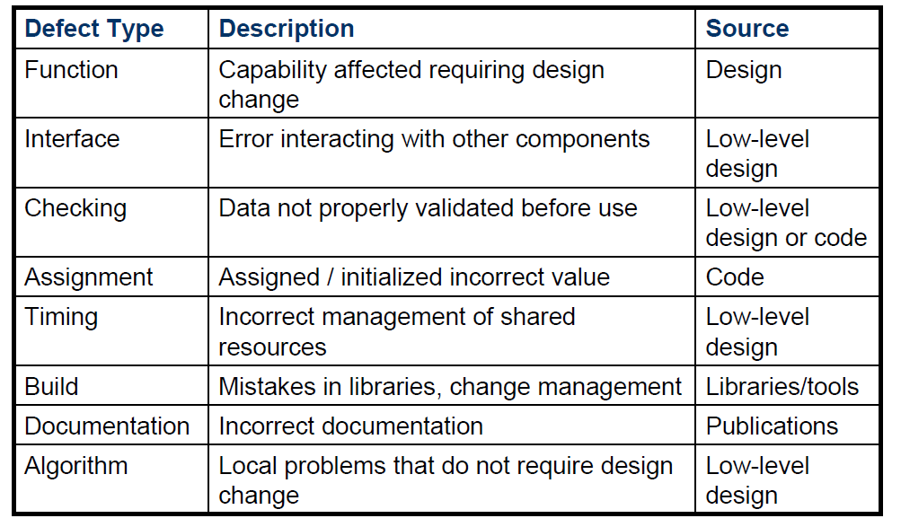
ODC: Bug Categories

Slide 6
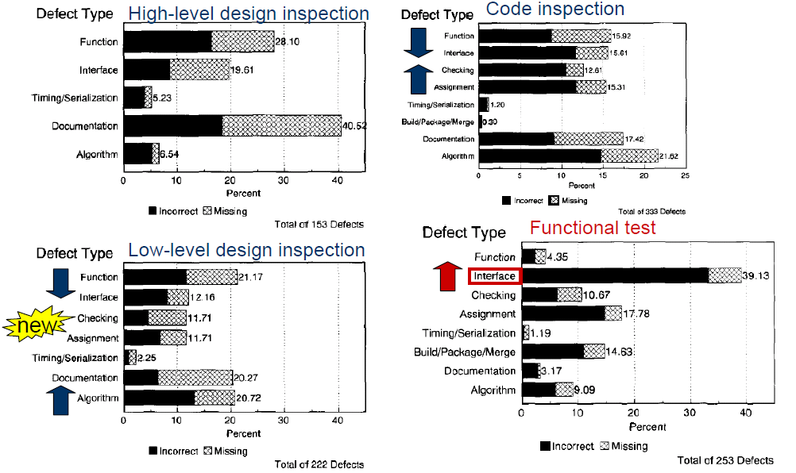
ODC: Signatures

Slide 7
ODC: Critique
Validity
How do we derive signatures
Can we use signatures from one company to understand another?
Lessons learned:
QA Processes correlates with bugs
Non-QA processes?

Slide 8
Code Complexity
Traditional metrics
Cyclomatic complexity (# control-flow paths)
Halstead complexity measures (# distinct operators/operands vs. # total operators/operands)
OO metrics
Traditional and OO code complexity metrics predict fault density

Slide 9
Pre vs. post-release
Less than 2% of faults lead to mean time to failure in less than 50 years!
Even among the 2% only a small percentage survive QA and are found post-release
Research question: Does code complexity predict post-release failures?

Slide 10
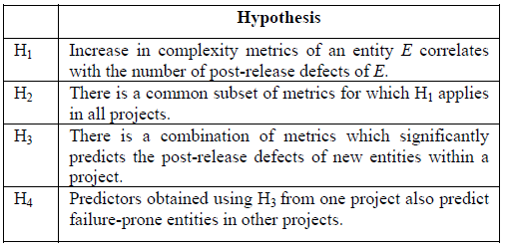
Mining: Hypotheses

Slide 11
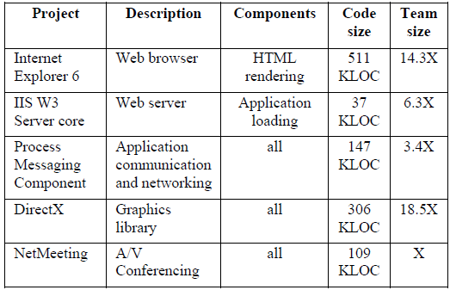
Mining: Methodology

Slide 12
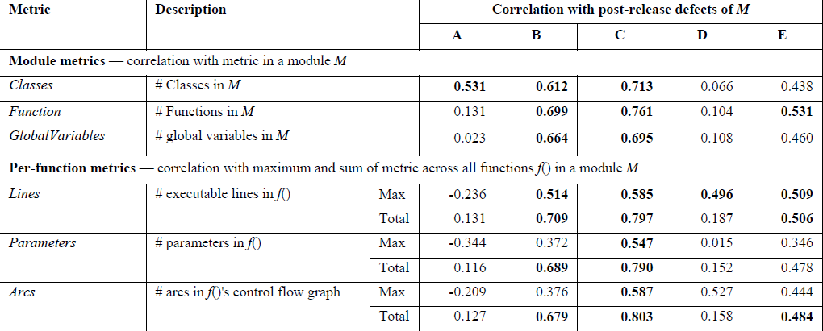
Mining: Metrics

Slide 13
Mining: Results 1
Do complexity metric correlate with failures?
Failures correlate with metrics:
B+C: Almost all metrics
D: Only lines of code
A+E: Sparse
Is there a set of metric predictive in all projects?
No!
Are predictors obtained from one project applicable to other projects?
Not really.

Slide 14
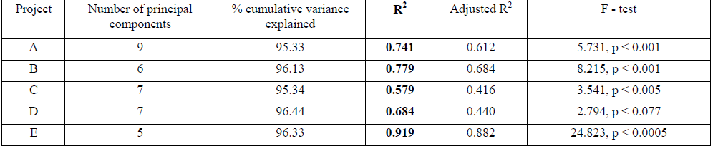
Mining: Results 2
Is a combination of metrics predictive?
Split projects 2/3 vs. 1/3, build predictor on 2/3 and evaluate prediction on 1/3.
Significant correlation on 20/25, less successful on small projects
Notes:
Predictor derived from principal components of project. Independent variable = components, dependant variable = post-release failures
Regression model

Slide 15
Mining Critique
Validity:
Fixed bugs
Severity
Lessons learned:
Complexity is an important predictor of bugs
No particular complexity metric is very good

Slide 16
Crosscutting concerns
Concern = “any consideration that can impact the implementation of the program”
Requirement
Algorithm
Crosscutting – “poor modularization”
Why a problem?
Redundancy
Scattering
Do crosscutting (DC) research question: Do crosscutting concerns correlate with externally visible quality attributes (e.g. bugs)?

Slide 17
DC: Hypotheses
H1: The more scattered a concern’s implementation is, the more bugs it will have,
H2: … regardless of implementation size.

Slide 18
DC: Methodology 1
Case studies of open source Java programs:
Select concerns:
Actual concerns (not theoretical ones that are not project specific)
Set of concerns should encompass most of the code
Statistically significant number
Map bug to concern
Map bug to code
Automatically map bug to concern from earlier mapping

Slide 19
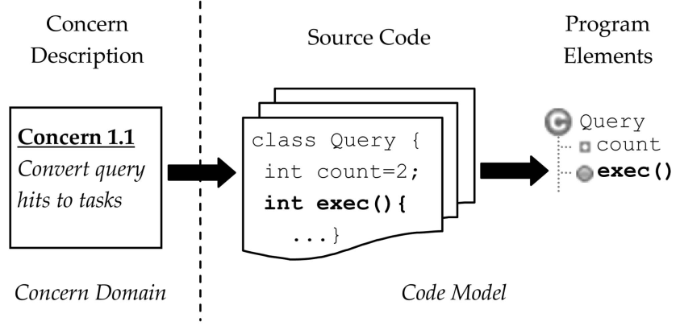
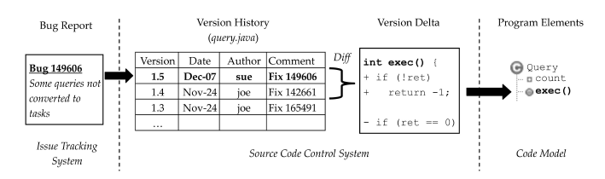
DC: Methodology 2
Case studies of open source Java programs:
Reverse engineer the concern code-mapping
Mine, automatically the bug code mapping
Notes:
A program is relevant to a concern if it should be removed or altered when the concern is pruned.

Slide 20
DC: Critique
Results:
Excellent correlation in all case studies
Validity:
Subjectivity of concern code assignment
Lessons learned:
Cross cutting concerns correlate with bugs
More data needed, but perhaps this is the complexity metric the Mining team was after

Slide 21
Conclusion
What causes bugs? Everything!
However, some important causes of bugs can be alleviated:
Strange bug patterns? Reshuffle QA
Complex code? Use new language and designs
Cross-cutting concerns? Refactor or use aspect-oriented programming

